Slide 1



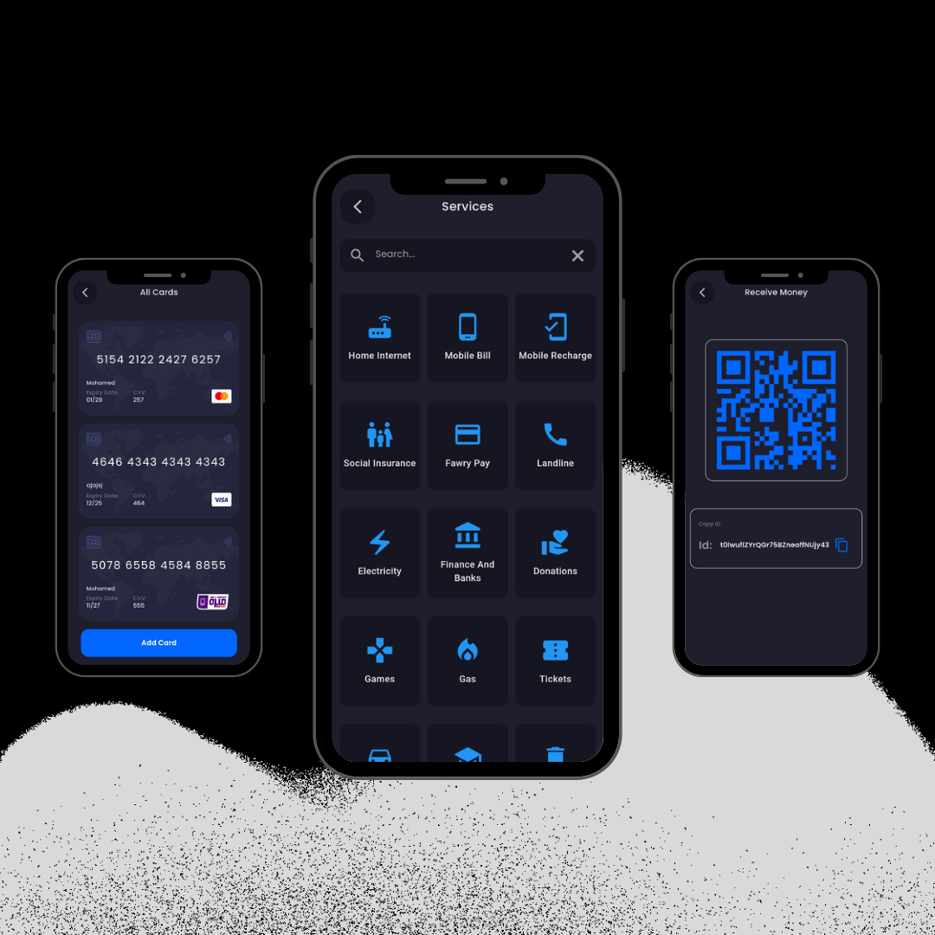
Welcome to Bank App
Bank App is your all-in-one solution to manage your finances with ease. Simplify your banking experience by accessing and managing all your credit and debit cards from various banks in one convenient place. Enjoy fast and secure transactions, real-time spending insights, and detailed expense tracking to stay on top of your financial well-being.

Slide 2
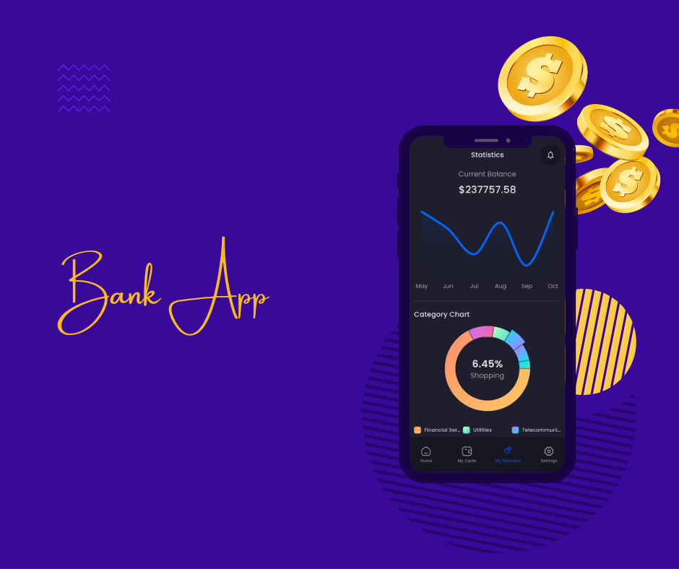
Our team
Mohamed Gehad Hussien
Ahmed Mohamed Salah
Hassan Sameh Hassan
Omar Mohamed Zaid

Slide 3
Manage Your Cards
Credit Cards
Debit Cards
Card Management
Conveniently view and manage all your credit card accounts from different banks. Monitor balances, due dates, and payment history in one centralized location. Easily make payments and track your credit utilization to maintain a healthy credit score.
Manage your debit cards from various banks seamlessly. Track your daily spending, monitor account balances, and set customized alerts to stay informed about your financial activities. Enjoy the convenience of making secure transactions with just a few taps.
Bank App's intuitive card management features allow you to easily add, delete, or block your cards as needed. Stay in control of your finances by monitoring your card usage, setting spending limits, and receiving instant notifications for any suspicious activities.

Slide 4
Secure Transactions
Biometric Authentication
Fraud Protection
Bank App leverages advanced biometric security features, such as fingerprint or facial recognition, to ensure the highest level of security for your transactions. Access your accounts and make payments with just a touch or a glance, eliminating the need for passwords or PINs.
Bank App's advanced fraud detection algorithms monitor your transactions in real-time, constantly scanning for any suspicious activities. You'll receive instant alerts if any potential fraudulent behavior is detected, allowing you to take immediate action to safeguard your finances.
1
2
3
Encrypted Data
All your financial data is encrypted and stored securely on Bank App's servers, protecting your sensitive information from unauthorized access. Rest assured that your personal and transaction details are kept confidential and safe.

Slide 5
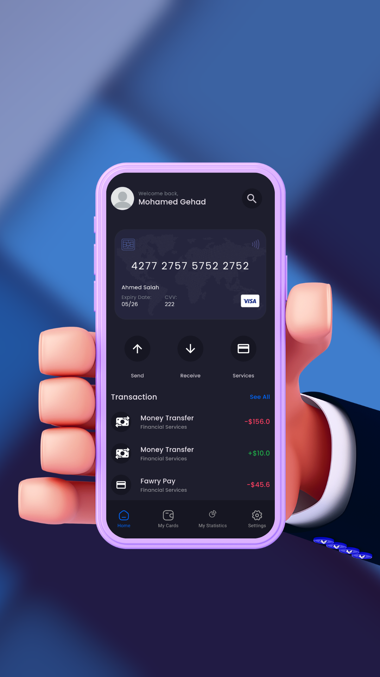
Real-Time Insights
Spending Tracking
Personalized Insights
Bank App's intuitive spending tracking features allow you to monitor your daily, weekly, and monthly expenses. Analyze your spending patterns, categorize your transactions, and set customizable budgets to gain a comprehensive understanding of your financial habits.
Receive personalized insights and recommendations based on your spending data. Bank App's algorithms analyze your financial behavior and provide tailored suggestions to help you optimize your spending, save more, and reach your financial goals.
Alerts and Notifications
Stay on top of your finances with customizable alerts and notifications. Get notified about upcoming bill payments, low account balances, unusual spending activities, and more. Bank App ensures you're always informed and empowered to make informed financial decisions.

Slide 6
Detailed Expense Tracking
Expense Categorization
Reporting and Analytics
Financial Goal Tracking
Bank App's advanced expense tracking features allow you to categorize your transactions into intuitive categories, such as groceries, dining, transportation, and more. Gain a deeper understanding of your spending habits and identify areas for potential savings.
Easily access comprehensive expense reports and detailed transaction histories within Bank App. Analyze your spending trends over time, track your budget allocations, and generate custom reports to make informed financial decisions.
Set personalized financial goals within Bank App, such as saving for a down payment or paying off debt. Monitor your progress, receive timely reminders, and adjust your goals as needed to stay motivated and on track with your financial objectives.

Slide 7
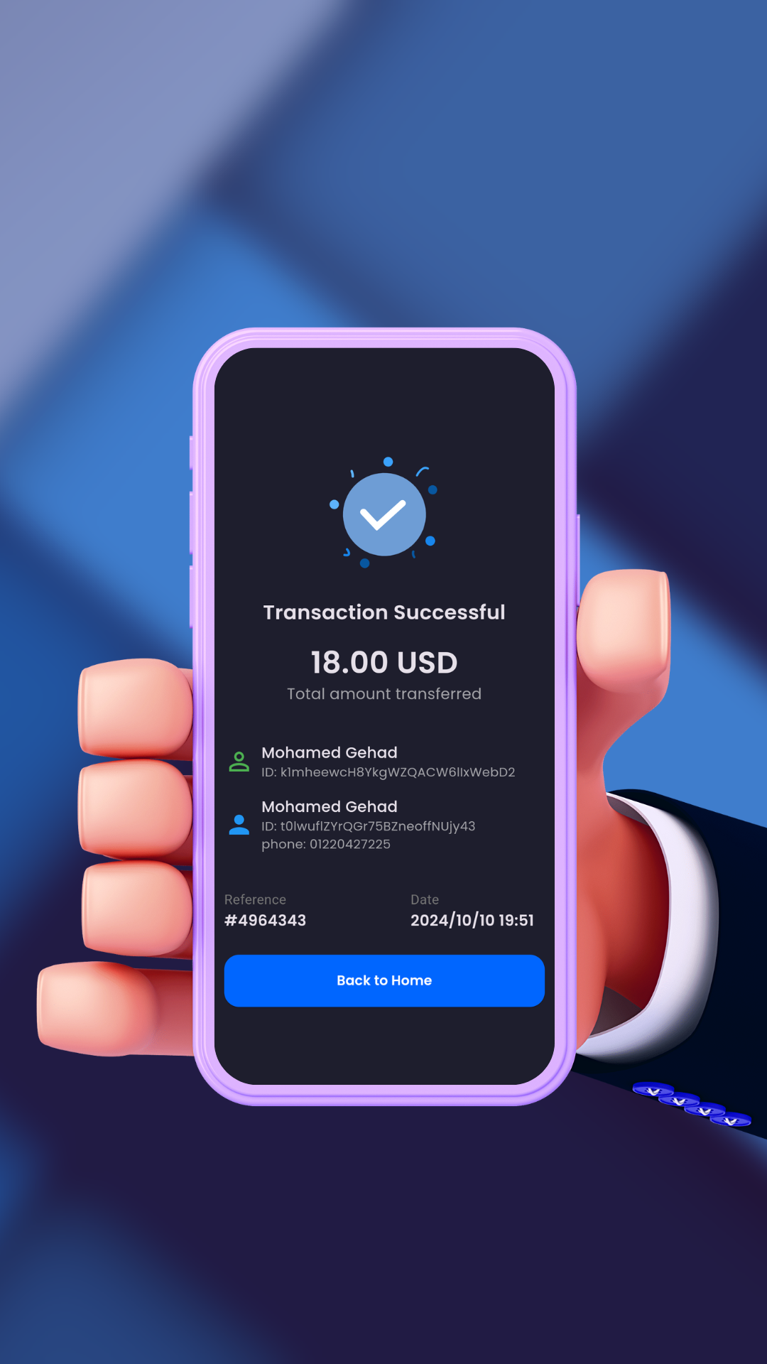



Seamless Integration
Connect Accounts
Easily link all your bank accounts, credit cards, and debit cards to Bank App, regardless of the financial institutions. Enjoy a seamless and comprehensive view of your entire financial landscape in one place.
Unified Transactions
Bank App automatically aggregates and categorizes all your transactions from the connected accounts, providing a centralized and organized view of your financial activities. Say goodbye to the hassle of managing multiple apps or accounts.
Synchronized Data
Bank App ensures that your financial data is constantly synchronized across all your connected accounts, ensuring that the information you see is always up-to-date and accurate. Stay informed about your finances in real-time, no matter where you are.

Slide 8




Top-Level Security
Encrypted Data
Fraud Protection
Biometric Authentication
Cloud-Based Backup
Bank App employs industry-leading encryption protocols to protect your sensitive financial data, ensuring that your personal information and transactions are kept safe from unauthorized access.
With advanced fraud detection algorithms, Bank App continuously monitors your account activity to promptly identify and flag any suspicious transactions, allowing you to take immediate action to safeguard your finances.
Bank App's secure cloud-based storage solution ensures that your financial data is safely backed up, allowing you to easily restore your information in the event of any device loss or damage.
Secure your account with Bank App's biometric authentication features, such as fingerprint or facial recognition. This added layer of security ensures that only you can access your financial information, providing peace of mind.

Slide 9

Take Control of Your Finances
1
Unified Financial Management
2
Easy Payment Services
Bank App brings all your financial accounts together in one convenient, user-friendly platform, empowering you to manage your finances with ease.
Use fast payment options that work for you. Get helpful tips and advice to manage your money, save more, and reach your financial goals with confidence.
3
Robust Security and Fraud Protection
4
Seamless Integration Across Banks
Rest assured that your financial data is safeguarded with advanced encryption, biometric authentication, and real-time fraud monitoring.
Enjoy a seamless banking experience by connecting all your accounts from different financial institutions, ensuring a comprehensive view of your finances.

Slide 10
Your Financial Future Starts Here
Simplified Banking
Comprehensive Insights
Top-Notch Security
Manage all your cards in one place
Real-time spending tracking and personalized recommendations
Advanced encryption and fraud protection
Fast and secure transactions
Detailed expense reports and goal tracking
Biometric authentication and cloud-based backup

Slide 11
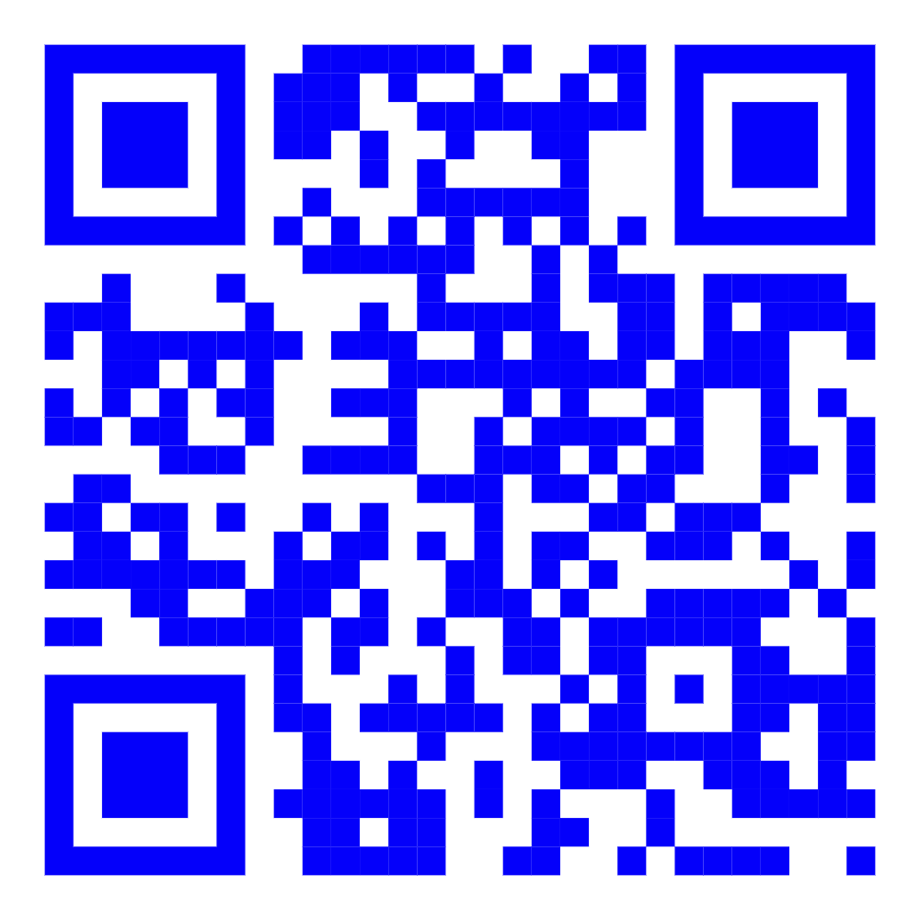
Download Bank App
Bank App is your all-in-one financial companion, designed to simplify your banking experience and empower you to take control of your financial future. Download Bank App today and enjoy the convenience of managing your credit and debit cards, tracking your expenses, and securing your financial data - all in one seamless platform.

